Slide 1



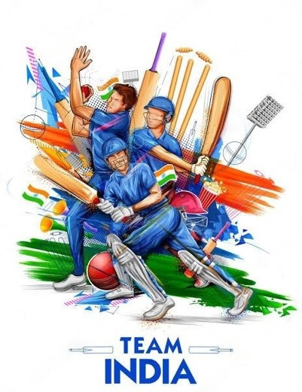


STATISTICAL ANALYSIS OF INDIAN CRICKET TEAM IN
ONE DAY INTERNATIONAL
A010
NIDHI KARAMBELKAR
A015
SEAN MINEZES
A016
AKSHAY MIRANI
A017
JASH MOZE
A020
VEER SHAH
Mentor: Prof Vaibhav Vasundekar

Slide 2


INTRODUCTION
In cricket, India has become a dominant force globally. This report presents statistics which highlight a story on India’s cricketing journey.
We aim at revealing the trends, highlights, and the pattern of the team’s achievement in ODI cricket. We’ll discuss how numbers can convey strengths, weaknesses, top players, and the group’s experience as a whole. We will examine different elements of the team’s statistical environment ranging from batting averages to bowling figures ,win-loss ratios and many more.
A One Day International (ODI) is a form of limited overs cricket, played between two teams with international status, in which each team faces a fixed number of overs, currently 50.[1]

Slide 3

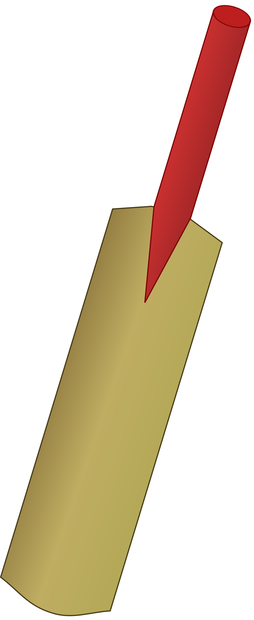

CRICKET TERMINOLOGIES
Batting Average - The total number of runs they have scored divided by the number of times they have been out.
Balls Faced - The total number of balls received, including no-balls but not including wides.
Batting Strike Rate-The average number of runs scored per 100 balls faced.
Inning-An innings is one of the divisions of a cricket match during which one team takes its turn to bat.
Batting Average - The total number of runs they have scored divided by the number of times they have been out.
Balls Faced - The total number of balls received, including no-balls but not including wides.
Batting Strike Rate-The average number of runs scored per 100 balls faced.
Inning-An innings is one of the divisions of a cricket match during which one team takes its turn to bat.
Bowling Average-The ratio of number of runs conceded per wickets taken
Economy Rate-Number of runs bowler is conceding per overs bowled.
Bowling strike rate-The average number of balls bowled per wicket taken.
Maidens-An over in which no wides or no balls are bowled, and no runs are scored off the bat.
Bowling Average-The ratio of number of runs conceded per wickets taken
Economy Rate-Number of runs bowler is conceding per overs bowled.
Bowling strike rate-The average number of balls bowled per wicket taken.
Maidens-An over in which no wides or no balls are bowled, and no runs are scored off the bat.
BOWLING
BATTING
BATTING

Slide 4

OBJECTIVES
To compare team’s Batting Performances of 2019 and 2022.
To test equality of means of Economy Rate of spinners and pacers.
To test Rohit Sharma’s Captaincy.
To test the independence of Venue and Outcome of the match.
To test the independence of toss winning and outcome of the match.
To test the variances of batting performances and Economy Rates.
To select ideal Indian cricket team for ODI

Slide 5

DATA
We have used secondary data for our research
Source: https://stats.espncricinfo.com/ci/engine/stats/index.html

Slide 6
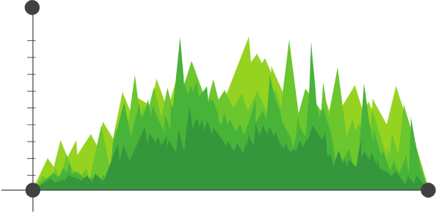
STATISTICAL ANALYSIS

Slide 7
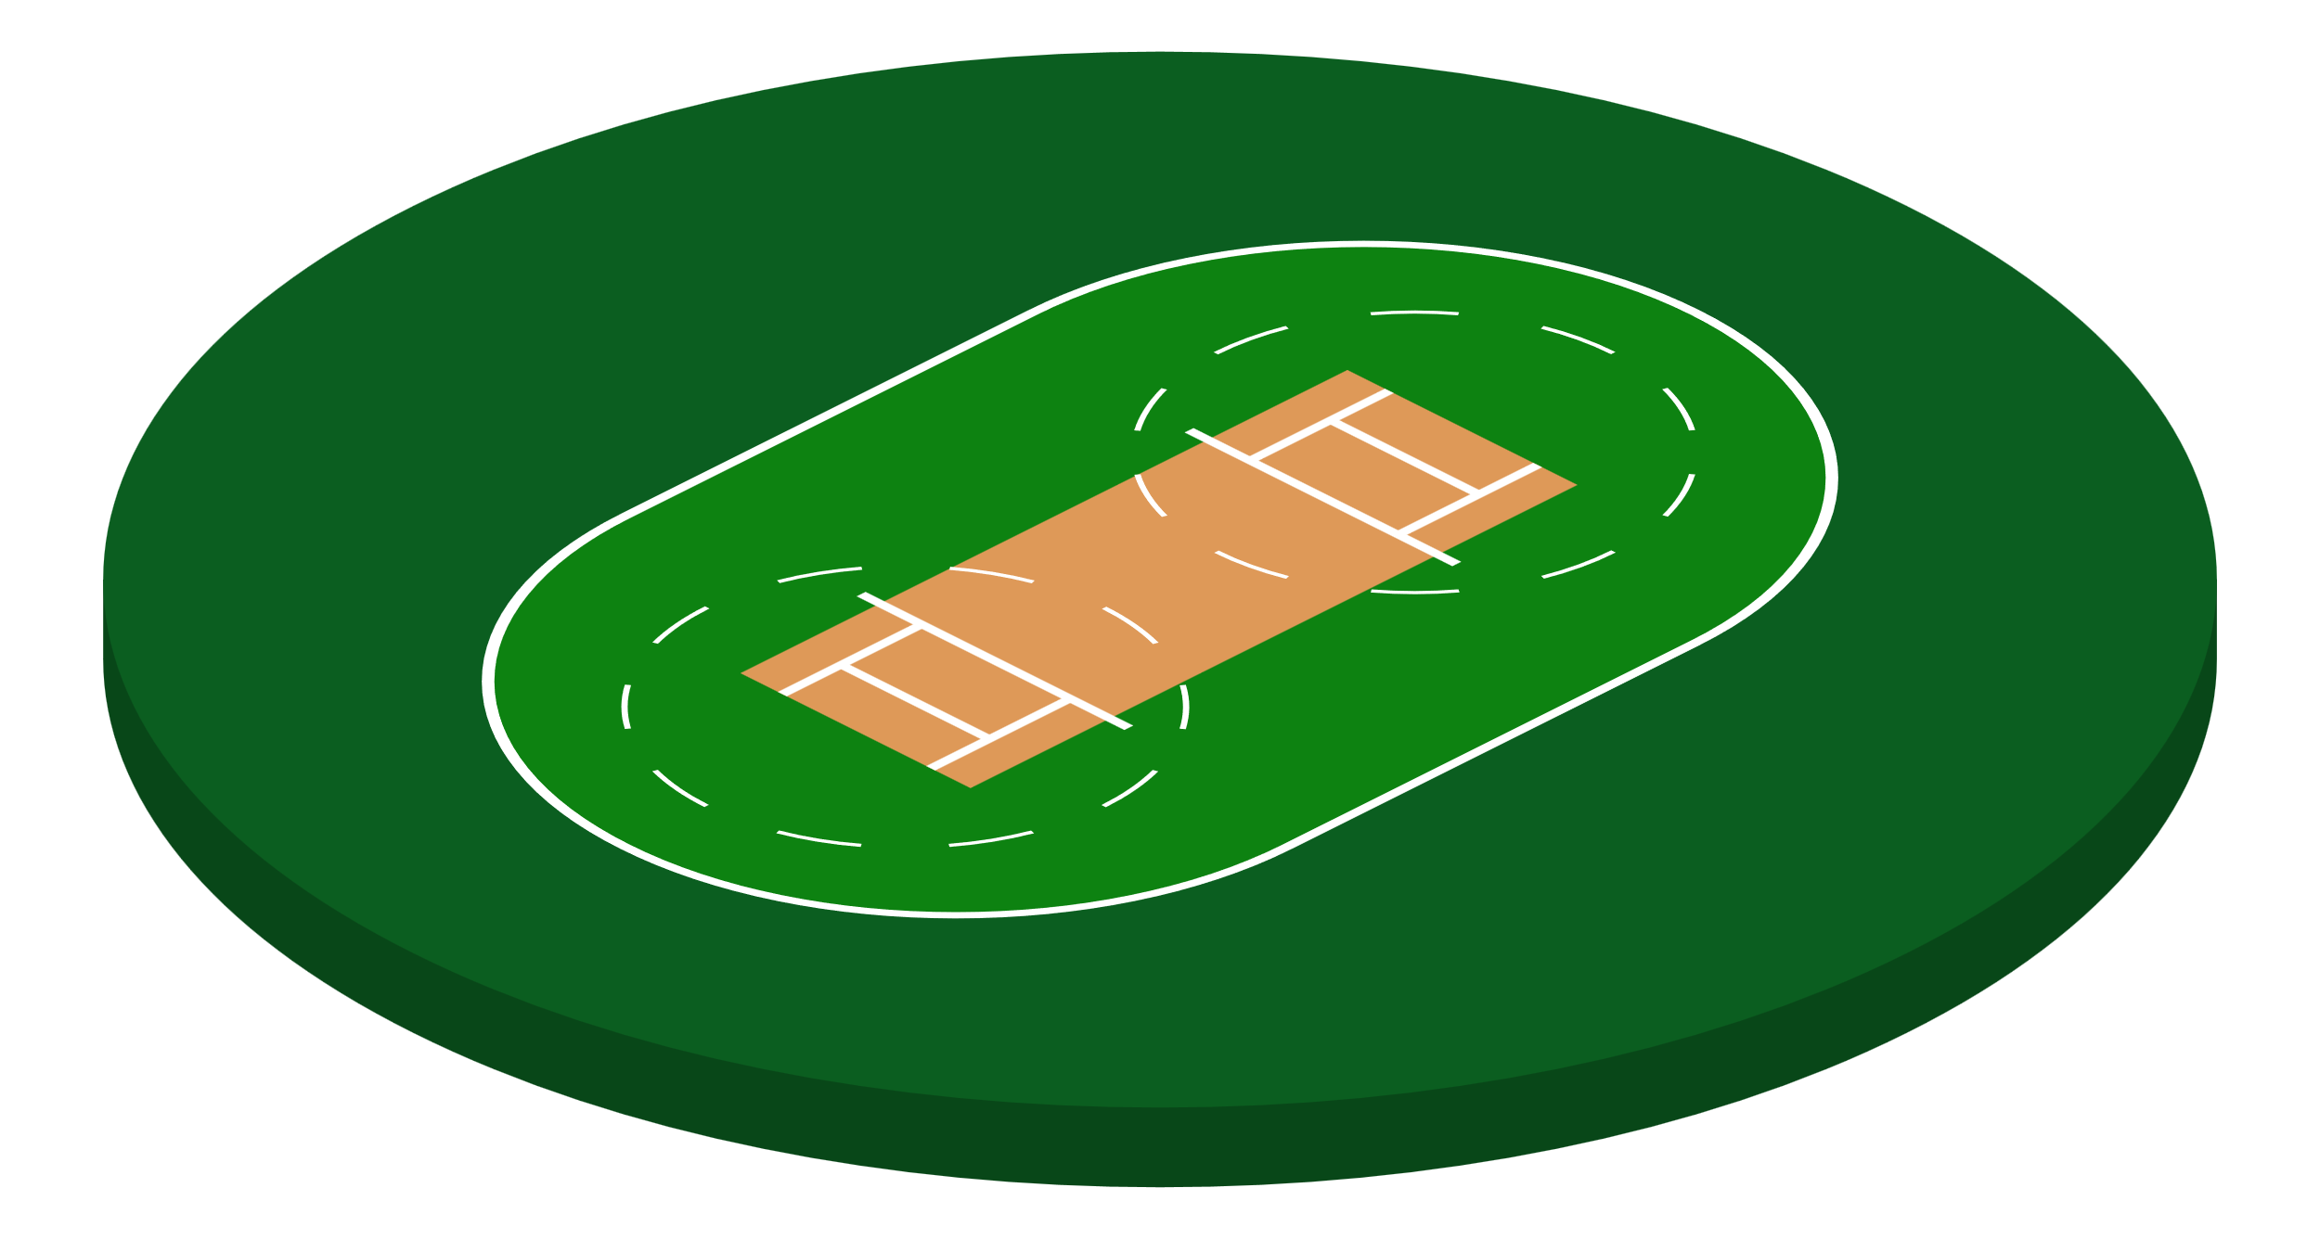
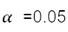
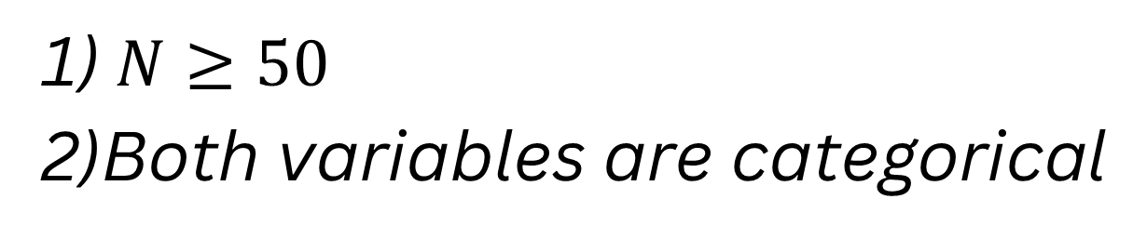
1)CHI SQUARE TEST OF INDEPENDENCE OF VENUE AND OUTCOME OF THE MATCH
ASSUMPTIONS:
1) $N≥50$
2)Both variables are categorical

Slide 8
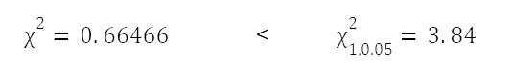
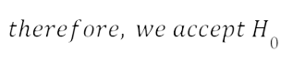
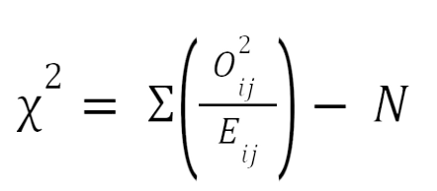
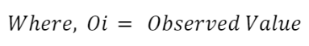
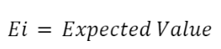
1)CHI SQUARE TEST OF INDEPENDENCE OF VENUE AND OUTCOME OF THE MATCH
Formula:
CONCLUSION:
Venue and Outcome of a match are independent.ICT has excellent adaptibility.

Slide 9

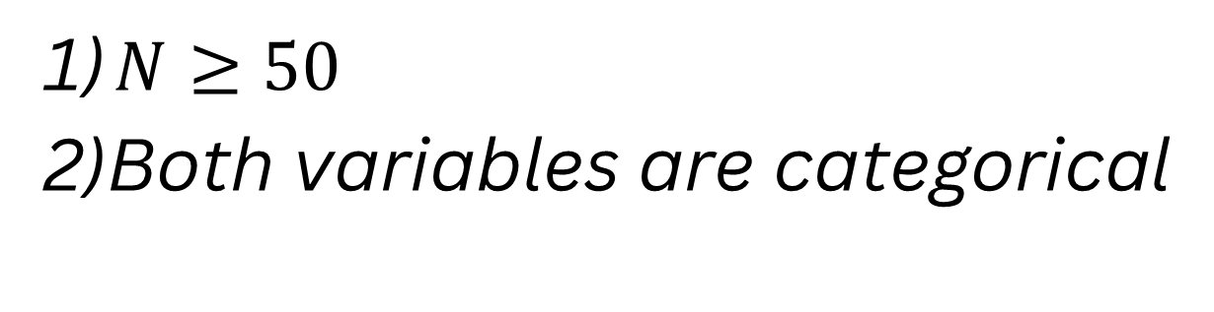
2)TO TEST THE INDEPENDENCE OF TOSS WINNING AND OUTCOME OF THE MATCH.
Formula:
ASSUMPTIONS:
1) $N≥50$
2)Both variables are categorical

Slide 10
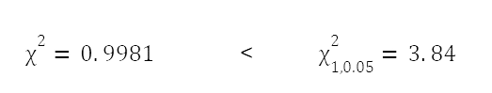
2)TO TEST THE INDEPENDENCE OF TOSS WINNING AND OUTCOME OF THE MATCH.
Formula:
CONCLUSION:
Winning a toss and the outcome of a match are independent.

Slide 11
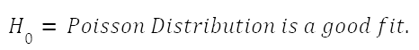
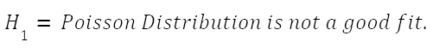

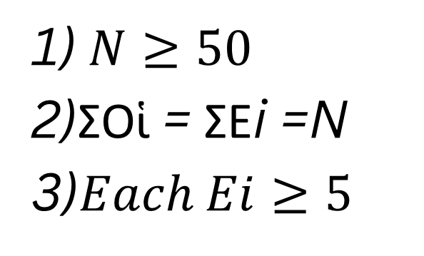
3) FITTING OF POISSON DISTRIBUTION
ASSUMPTIONS:
1) $N≥50$
2)ΣΟἱ = ΣΕi =N
3)$Each Ei≥5$

Slide 12
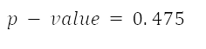
3) FITTING OF POISSON DISTRIBUTION
CONCLUSION:
Since P-value is greater than 0.05 therefore we accept null hypothesis Poisson Distribution is a good fit

Slide 13
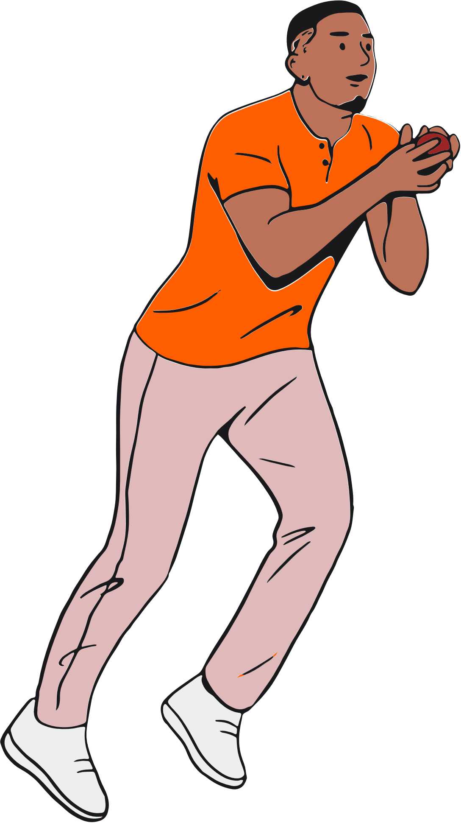
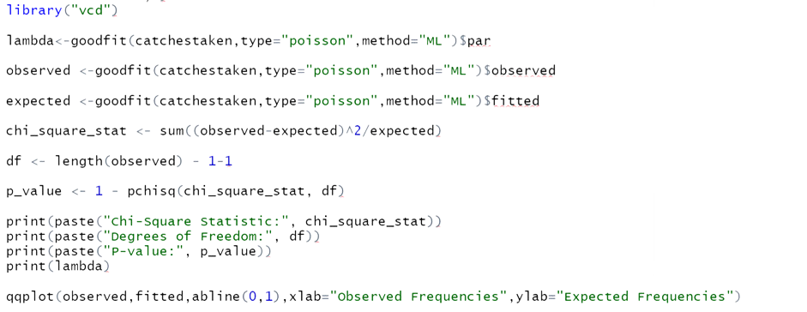
CODE

Slide 14
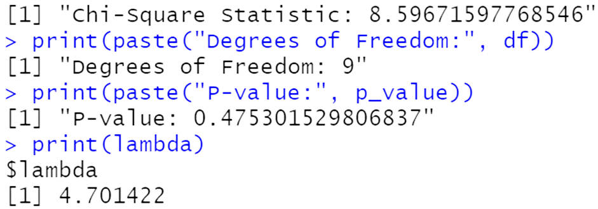

OUTPUT

Slide 15
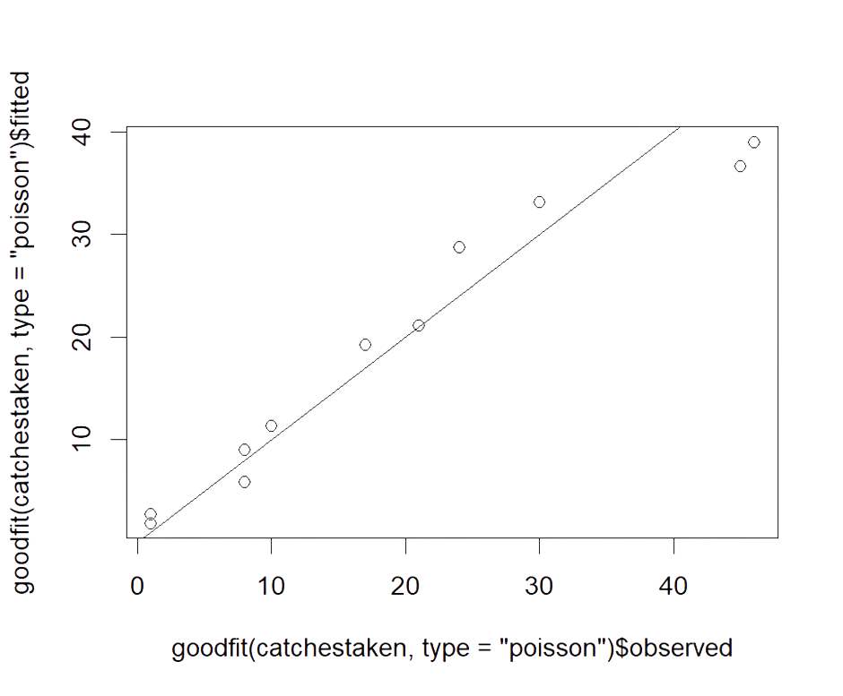

Q-Q PLOT OF OBSERVED AND EXPECTED FREQUENCY OF CATCHES TAKEN
Expected frequency
Observed Frequency

Slide 16
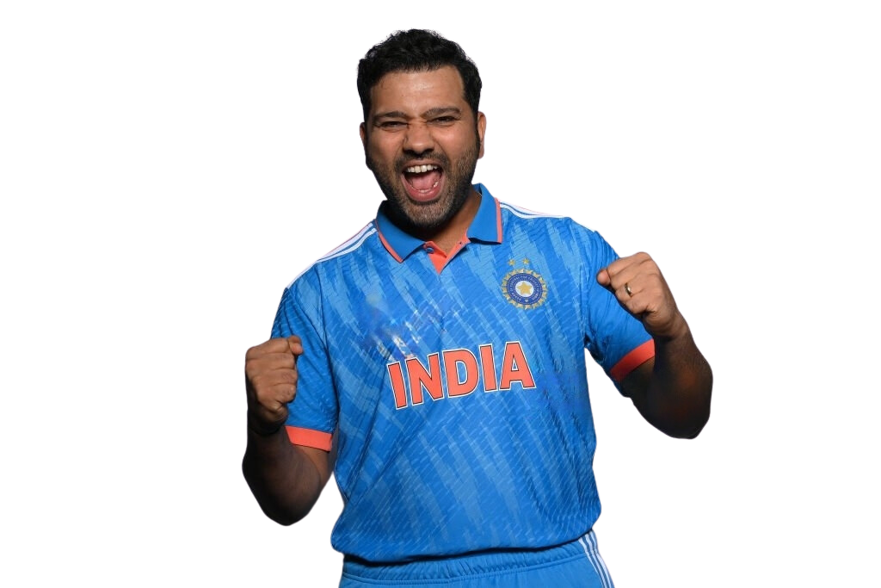
4) TESTING CAPTAINCY OF ROHIT SHARMA FOR THE YEARS 2019-2023 USING BINOMIAL TEST OF SINGLE POPULATION PROPORTION.
ASSUMPTIONS:
1)The outcome of each observation is binary
2)Each observation or trial is independent of others.
3)Random sampling
4)Fixed number of trials

Slide 17
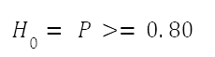
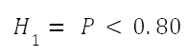
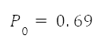
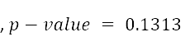
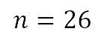
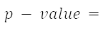
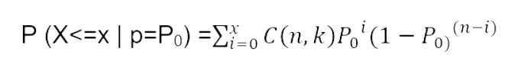
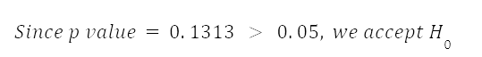
4) TESTING CAPTAINCY OF ROHIT SHARMA FOR THE YEARS 2019-2023 USING BINOMIAL TEST OF SINGLE POPULATION PROPORTION.
$$≥$$
,
=0.05
Formula:
Conclusion:

Slide 18
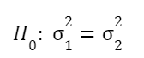
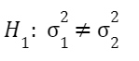

5)COMPARING VARIANCES OF TWO INDEPENDENT POPULATIONS OF ECONOMY RATES OF FAST BOWLERS AND SPINNERS
ASSUMPTIONS:
1) The populations follow normal distribution
2)The populations are independent
3)Greater of the 2 variances is to be taken in the numerator
and n1 corresponds to the greater variance.

Slide 19
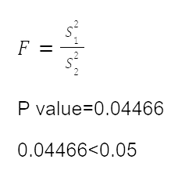
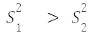
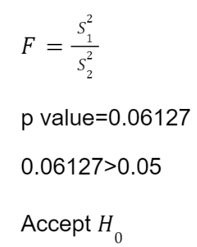
5)COMPARING VARIANCES OF TWO INDEPENDENT POPULATIONS OF ECONOMY RATES OF FAST BOWLERS AND SPINNERS
Formula:
CONCLUSION:
Variances of Economy Rates of bowlers is same

Slide 20
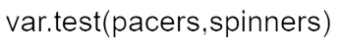
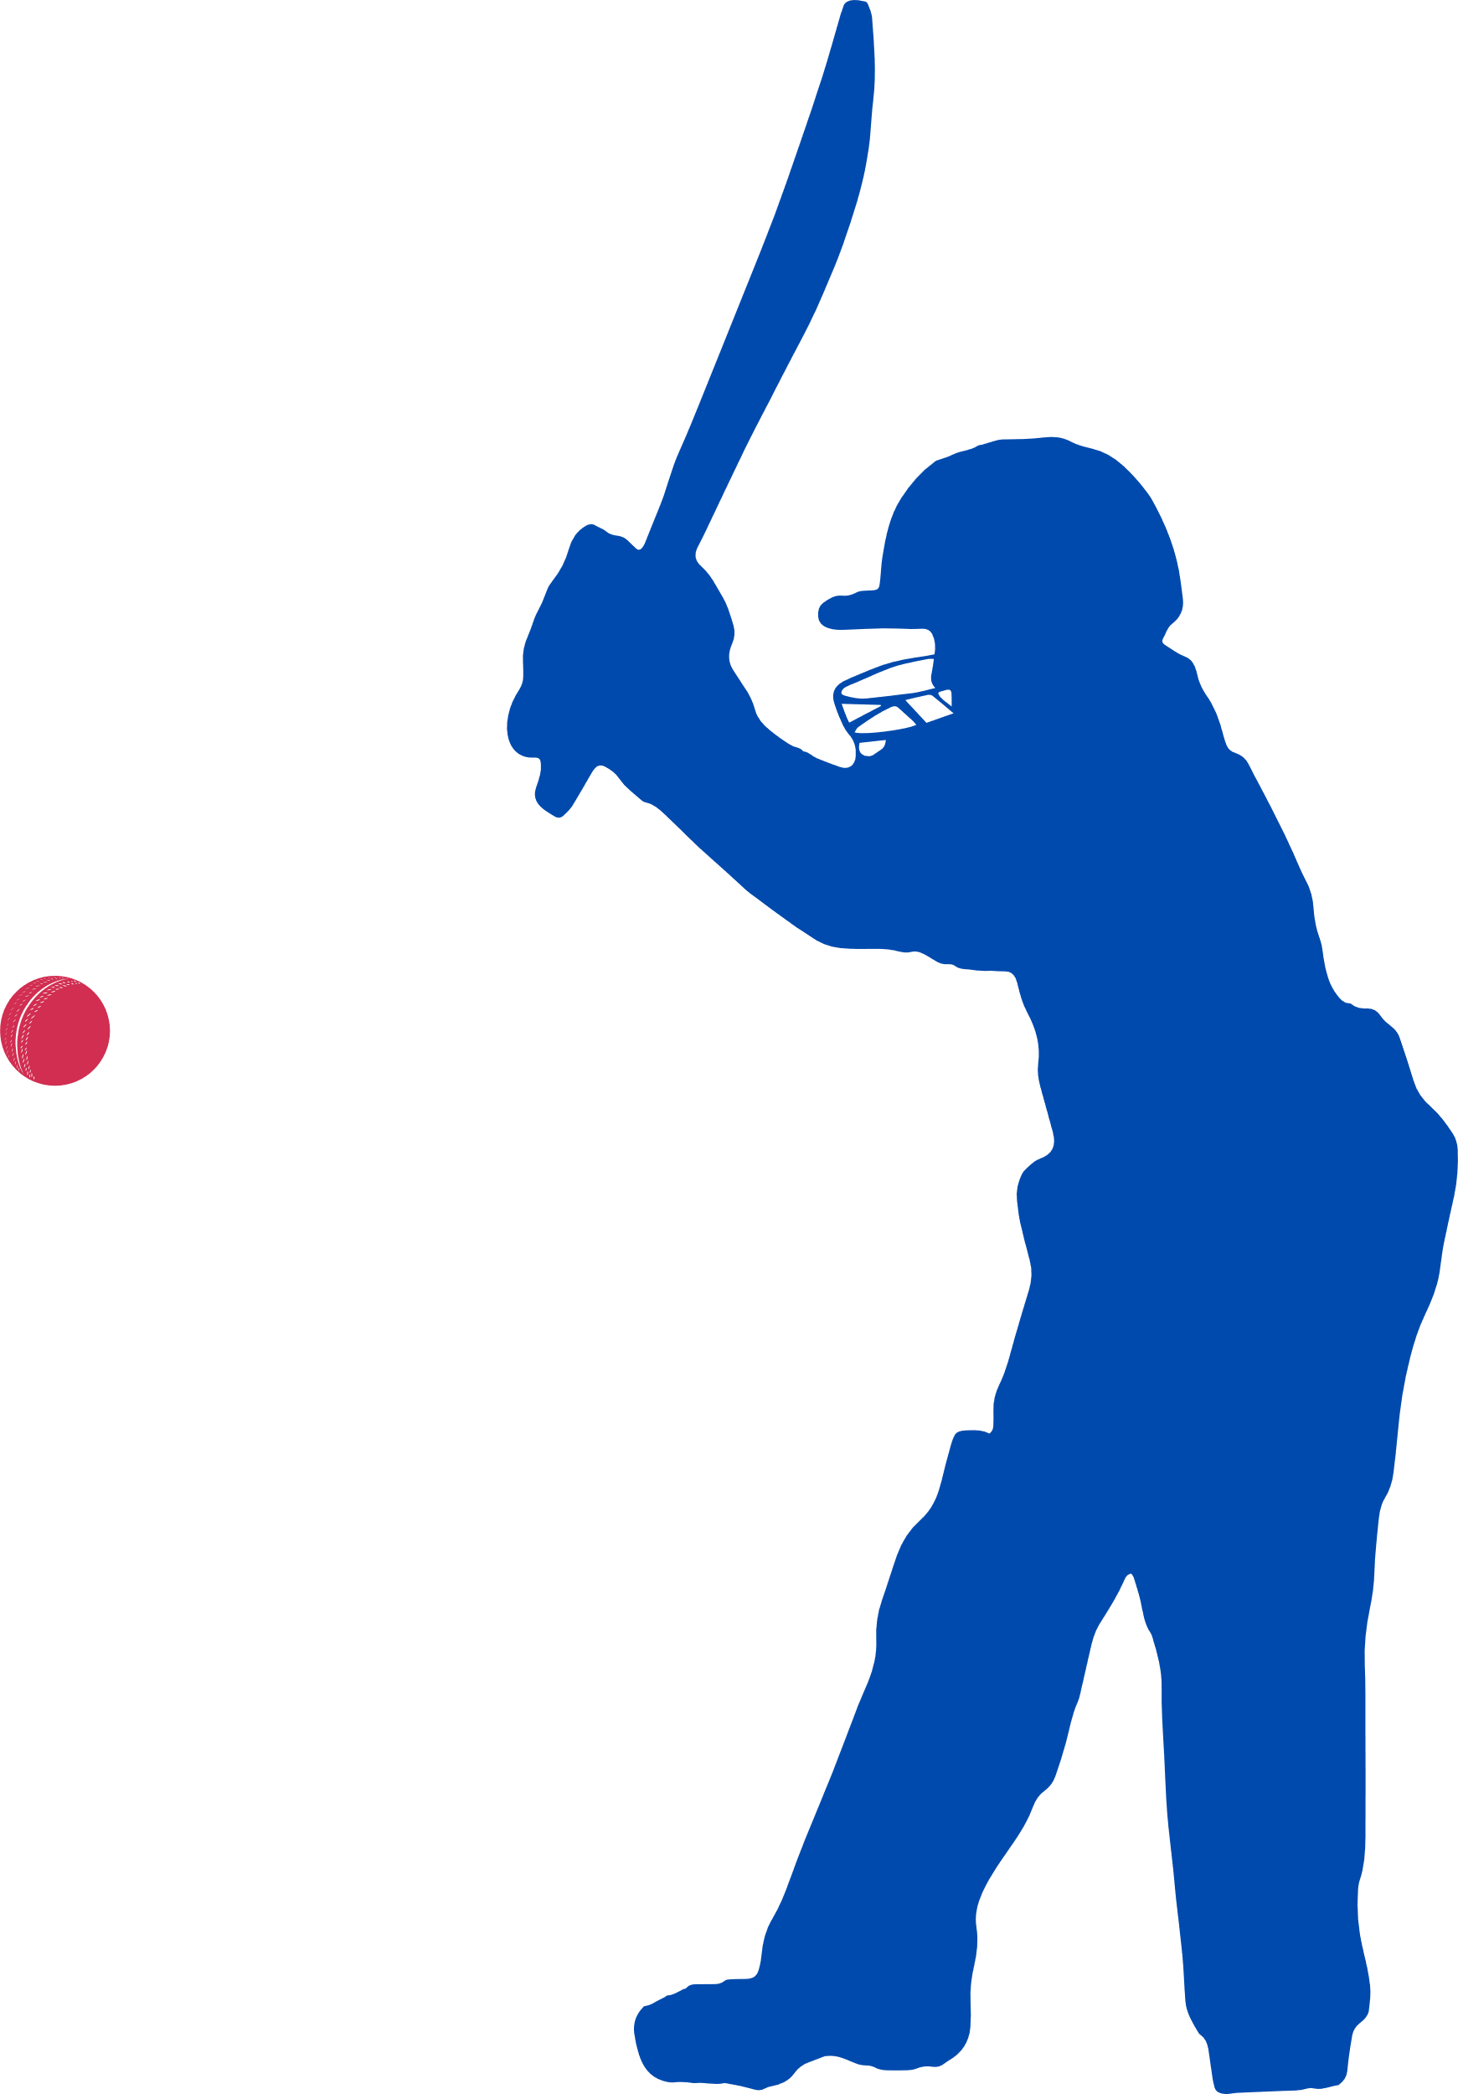
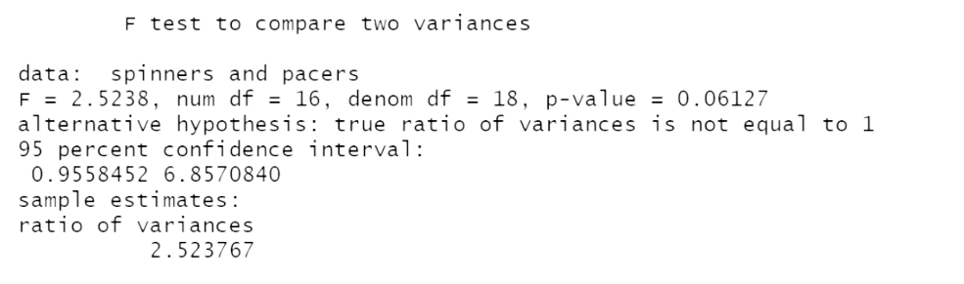
CODE
OUTPUT

Slide 21
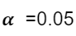
6) TESTING FOR EQUALITY OF MEAN OF ECONOMY RATE OF SPIN BOWLER AND FAST BOWLER.
ASSUMPTIONS:
1)The two samples are independent
2)Both samples have been drawn from normal population
3)Population variances are equal and unknown

Slide 22
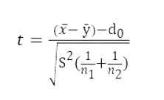
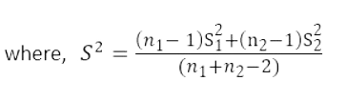
6) TESTING FOR EQUALITY OF MEAN OF ECONOMY RATE OF SPIN BOWLER AND FAST BOWLER.
Formula:

Slide 23
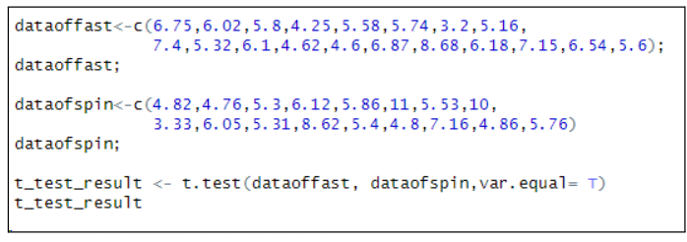

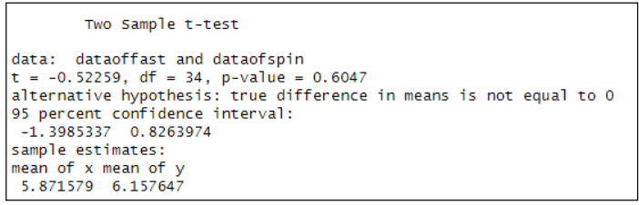
CODES
CONCLUSION:
The means of Economy Rate of spin bowler and fast bowler are equal.
Hence,we can conclude that the performance of both spinners and fast bowlers is equally good for the team.
OUTPUT

Slide 24
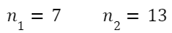

7)COMPARING VARIANCES OF TWO INDEPENDENT POPULATIONS OF BATTING PERFORMANCE PLAYERS IN 2019 TO 2022
ASSUMPTIONS:
1) The populations follow normal distribution
2)The populations are independent
3)Greater of the 2 variances is to be taken in the numerator
and n1 corresponds to the greater variance.

Slide 25
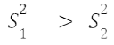
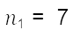
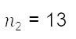
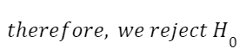
7)COMPARING VARIANCES OF TWO INDEPENDENT POPULATIONS OF BATTING PERFORMANCE PLAYERS IN 2019 TO 2022
Formula:
CONCLUSION:
Variance of both the population of batting performances are not same

Slide 26
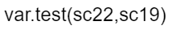
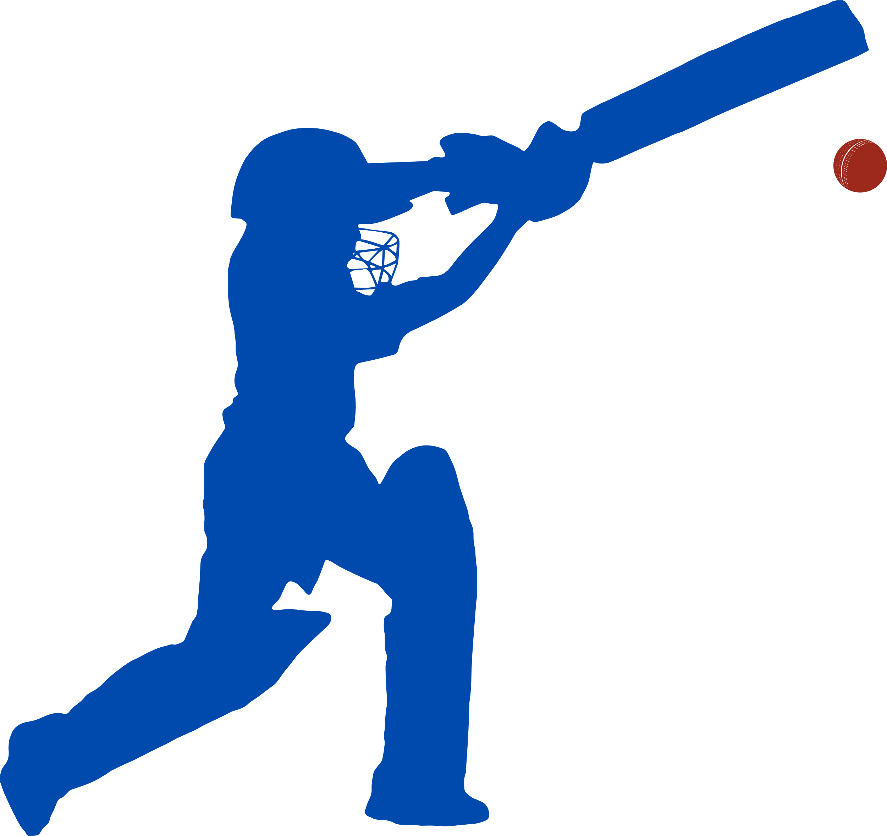

CODE
OUTPUT
CONCLUSION:
Variance of both the population of batting performances are not same

Slide 27
8) COMPARING TEAM BATTING PERFORMANCES OF 2019 AND 2022 USING T-TEST FOR 2 POPULATION MEAN.
ASSUMPTIONS:
1)The two samples are independent
2)Both samples have been drawn from normal population
3)The variances are unequal and unknown

Slide 28





8) COMPARING TEAM BATTING PERFORMANCES OF 2019 AND 2022 USING T-TEST FOR 2 POPULATION MEAN.
Formula:

Slide 29


CODES
CONCLUSION:
Mean batting performance of both years is same.
ICT is consistent.
OUTPUT

Slide 30

SELECTION OF AN
IDEAL TEAM

Slide 31

SELECTION OF BATTERS- ROUND 1
From ESPN website, the data of batters of Indian Cricket Team was taken.It consisted of 49 players.
We considered 3 parameters as part of the first round of selection.The parameters were Strike Rate,Avg,Highest score,
The top 20 batters in each of the above parameters were chosen in that parameter.The batters that made it to the top 20 of every parameter were considered as potential batters.
This resulted in having a total of 13 potential batters.

Slide 32
SELECTION OF BATTERS- ROUND 2
A Batting Index which was more comprehensive was chosen for second round of selection .
Batting index= Batting Average x Strike Rate x Consistency xWeighted Number Centuries x Weighted Number of Half Centuries xWeighted Experience x Weighted Hard hitting ability
Consistency= (Amount of runs/Number of innings)
Hard Hitting Ability=(Number of fours + Number of Sixes)/Balls Faced.[2]
Experience=2023-ODI Debut year

Slide 33



SECOND ROUND OF SELECTION OF POTENTIAL BATTERS
Please note that RR pant is eliminated from the second selection procedure because he has been injured since December 2022.He is not fit to be a part of the current ODI team.

Slide 34






BATTERS
ROHIT SHARMA
TOP ORDER BATTER
VIRAT KOHLI
TOP ORDER BATTER
SHREYAS IYER
TOP ORDER BATTER
SHUBMAN GILL
OPENING BATTER
ISHAN KISHAN
WICKETKEEPER BATTER

Slide 35
SELECTION OF BOWLERS- ROUND 1
The data regarding the bowlers was taken from ESPN. It consisted of 49 players.
We considered 3 parameters as part of the 1st round of selection.The parameters considered were economy, bowling average and strike rate.
The top 20 bowlers in each of the above parameters were chosen in that parameter. The bowlers that made it to the top 20 of every parameter were considered as potential bowlers.
This resulted in having a total of 13 potential bowlers.

Slide 36

SELECTION OF BOWLERS- ROUND 2
A Bowling Index which was more comprehensive was chosen.
BOWLING INDEX:
(WEIGHTED MAIDEN X WEIGHTED WICKETS)
(WEIGHTED ECONOMY X WEIGHTED STRIKE RATE X WEIGHTED BOWLING AVERAGE)

Slide 37

SECOND ROUND OF SELECTION OF POTENTIAL BOWLERS

Slide 38





BOWLERS
JASPRIT BUMRAH
RIGH ARM FAST
MOHAMMED SIRAJ
RIGHT ARM FAST
KULDEEP YADAV
LEFT ARM WRIST SPIN
YUZVENDRA CHAHAL
LEGBREAK GOOGLY

Slide 39

SELECTION OF ALL ROUNDERS- ROUND 1
The data of All rounders was taken from ESPN.ICT had a total of 16 Batting all rounders and 12 Bowling all rounders.
The players who were common in both batting and bowling all rounders were chosen.

Slide 40

SELECTION OF ALL ROUNDERS- ROUND 2
All rounder index was calculated for these players.
All rounder index= Batting Index x Balling Index
Batting Index= Batting Average x Strike Rate x Consistency x Weighted Number of Half Centuries x Weighted Experience x Weighted Hard hitting ability
Bowling index:
(weighted maiden x weighted wickets)
(weighted economy x weighted strike rate x weighted bowling average)

Slide 41


SECOND ROUND OF SELECTION OF POTENTIAL ALL ROUNDERS

Slide 42


ALL ROUNDERS
HARDIK PANDYA
RAVINDRA JADEJA

Slide 43













Slide 44

FUTURE SCOPE
Future research can explore how specific player statistics impact a team's success in different game formats.
Comparing Indian Cricket Team's stats with those of other top cricketing nations can identify areas for improvement and strengths.
Advanced machine learning algorithms can help develop predictive models to guide team selection, strategy formulation, and performance evaluation.
Incorporating more years of data and additional parameters, such as fielding statistics, can provide a comprehensive view of player contributions.
These extensions can enhance sports analytics, particularly in cricket.

Slide 45

CONCLUSION
The study found that factors such as venue, toss outcome, and match outcome are independent of each other. The team's performance is consistent.
A proposed team selection based on calculated indexes resulted in a balanced team with a mix of batters, bowlers, spinners, and all-rounders. The study highlights the importance of statistical analysis in sports and demonstrates how data-driven insights can contribute to strategic decision-making in cricket.
Sets a precedent for how data-driven decision-making can revolutionize the world of sports. Here, every run, every wicket, and every catch is a story told by data.

Slide 46
REFERENCES
[1] WIKIPEDIA CONTRIBUTORS, “ONE DAY INTERNATIONAL,” WIKIPEDIA, OCT. 29, 2023. HTTPS://EN.WIKIPEDIA.ORG/WIKI/ONE_DAY_INTERNATIONAL
[2] PREDICTING OPTIMAL CRICKET TEAM USING DATA ANALYSIS RESEARCH PAPER

Slide 47



